Slide 1
RDBMS IA-1
Query Driven implementation of Twitter base using Cassandra
by Dharavath Ramesh, Anand Kumar
Harsh Shah - 1911081

Slide 2
CONTENTS
01
NoSQL
02
Cassandra
`
03
Twitter & Cassandra
04
Query Driven Model
05
Conclusion

Slide 3
01
NoSQL
NoSQL databases (aka "not only SQL") are non tabular, and store data differently than relational tables.

Slide 4
1
NoSQL
Why NoSQL?
The 21st century saw the rise of Web 2.0 companies like Facebook, Google, Amazon, Twitter etc. The big data challenges rising from these triggered a surge in the demand for NoSQL databases. The shift from relational data models to non-relational ones can be attributed to:
The relational model does not provide enough flexibility to handle operations on big data.
The static nature of the relational data models makes them inefficient in handling time series applications as well as high velocity data.
RDBMS is vertically scalable i.e. its limits are defined by hardware as compared to horizontal scalability of NoSQL databases which allows increase in capacity by simply connecting multiple hardware or software entities.

Slide 5


1
NoSQL
Solution: Cassandra
Cassandra’s ability to handle the discrete time series data efficiently raises its stake to be an ideal fit for this use case. To accommodate this instance, in this paper, a Cassandra data model is suggested primarily for storing the tweets and maintaining the timeline of each and every user on Twitter.
Twitter’s dilemma
Twitter is a microblogging site with millions of users around the globe.
Twitter juggles around 10,000 tweets per second (500 million per day) and hence efficient storage of these tweets is of primary importance to them.

Slide 6
02
Cassandra
Apache Cassandra is a free and open-source, distributed, wide-column store, NoSQL DBMS designed to handle large amounts of data across many commodity servers, providing high availability with no single point of failure.

Slide 7
2
Cassandra
Why Cassandra?
Designed to run on cheap community hardware.
Stores data in append only format thus providing the most efficient write operation among all other NoSQL databases.
Thousands of nodes that can be deployed across multiple data centers.
Cassandra performs six times faster than HBase and 195 times faster than MongoDB.
Since data are stored in a sequential fashion in Cassandra, it offers an obvious advantage in storing huge chunks of data which form some sort of sequence. Hence, the number of data retrievals per second increases many fold leading to fast read operation. Cassandra offers much higher scalability when data is heavily concentrated in a small time interval (e.g. discrete time series data).

Slide 8
2
Cassandra
Cassandra follows the CAP theorem also known as Brewer’s theorem. This theorem states that any distributed data store can maximally ensure two of the following three features:
Consistency
Availability
Partition tolerance
The read operation should return the most
recent writes on the database.
No request to the server should be devoid of
response.
System continues to operate even if
there are arbitrary partitions due to network failures.
A tradeoff between consistency and availability occurs only when a network failure occurs. Cassandra gives upper hand to availability over consistency in such situations and this feature only makes Cassandra an apt NoSQL database in dealing with big data.
For web 2.0 sites, eventual consistency is the main source to perform related operations i.e. it is not necessary to load the data posted milliseconds before on the user’s timeline. However, the system needs to be available even in the case of multiple network failures.

Slide 9
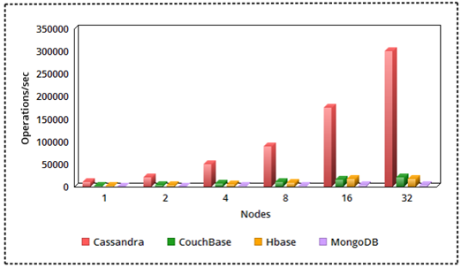
2
Cassandra
Performance of
Cassandra
This figure compares the number of operations per second per node cluster performed by the various NoSQL databases and its quite apparent that performance of Cassandra better as the number of nodes grow in the cluster and hence Cassandra emerges as a clear choice for managing huge workloads among all NoSQL databases.

Slide 10
03
Twitter & Cassandra

Slide 11
3
Twitter & Cassandra
Transition from SQL to NoSQL
Twitter was built on MySQL and originally all data was stored on it.
The vertical scalability of MySQL made it difficult to distribute data as the network traffic increased million folds.
In 2010, the designers of Twitter introduced framework named Gizzard for creating distributed data stores. The ecosystem at that time was replicated using MySQL clusters and Gizzard based sharded MySQL clusters.
They also introduced FlockDB, a graph storage solution on top of Gizzard and MySQL.
In 2010, the methodology of Hadoop has been adopted to store MySQL backups. However, it is now heavily used for analytics.
On the other hand, they added Cassandra as a storage solution. However, they didn’t store tweets in the Cassandra database. As traffic grew exponentially they launched Manhattan in 2014.

Slide 12
04
The Query Driven Model

Slide 13
4
The Query Driven Model
Data Models in Cassandra
Any data model designed in Cassandra should achieve the following two goals:
Spread data evenly among the nodes in the cluster: We want every node to have almost same amount of data so that formation of hotspots can be avoided in the cluster. A token is derived from the partition key (first element of primary key) value in each row, which determines the node on which that particular row will be stored. Hence a good primary key should be chosen.
Minimize the number of partition reads: Since different partitions may reside on different nodes, the coordinator node will have to issue separate commands to separate nodes for each partition you request leading to large overhead cost.

Slide 14

4
The Query Driven Model
Data Model for Twitter base
The author keeps the two goals in context and designs a data model that creates a column family database(tweets), which will have single tweet stored per row and the columns contain information regarding each tweet e.g. time of the tweet, name of the user publishing the tweet, text in the tweet and an id which uniquely identifies the tweet.
They choose tweetid column as the partition key to ensures that the tweets are distributed evenly across the nodes in a cluster.
Each user will have a unique column family having all the tweets which are to be shown on the twitter timeline of that particular user with column values like time of the tweet, id of the tweet.

Slide 15
4
The Query Driven Model
When a tweet is posted by a user, the complete information about that tweet will be stored as a row in the tweets column family. The tweet id and the time of the tweet will be stored in usertimeline column family of all the followers of that particular user. This avoids multiple writes of the same data in other column families.
The timeline of any user can now be published by simply querying all the rows from the usertimeline column family corresponding to that user.
The main challenge is to pick the most optimal primary key for ordering the tweets in descending order of time.
The tweets will be distributed on different nodes according to the token generated from the tweetid value and will be stored in descending order of time in each partition.Thus the functionality of tweettime cant be chosen as the primary key.
Now if we use this CQL command, we get the timeline of user1. However, the timeline may not have tweets sorted by descending order of time as the tweets stored on node1 are sorted among themselves, tweets stored on node2 are sorted among themselves, but the tweets on node1 and node2 combined may not be sorted at all.

Slide 16

4
The Query Driven Model
The author explores using dummy column (column having same value for all rows) as partition key and tweettime as clustering column but concludes that it was not an ideal method.
The author decides to introduce a column tweetnode in the user1timeline column family which takes the value like 201707 or 201708 i.e. the year in which the tweet was posted concatenated with the month.This column is now the partition key and tweettime is the clustering column.The following CQL command is used:
This way,tweets posted in the same month will have the same partition key and hence the same node. Thus they are sorted in descending order of time and the user timeline has tweets in desired order.

Slide 17
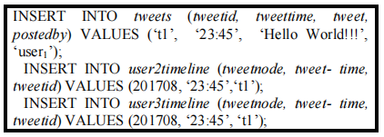

4
The Query Driven Model
Storage & Retrieval of Tweets
The following CQL commands are used for read and write operation:
Write:
Read:

Slide 18
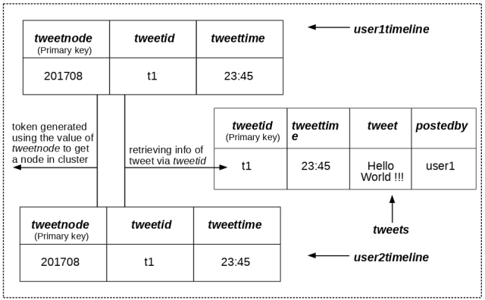
4
The Query Driven Model
Storage & Retrieval of Tweets
Let user1 posts a tweet and user2 and user3 are following user1. We store the complete information about the tweet in tweets column family. The tweetid and tweettime along with tweetnode value will be stored in user2timeline and user3timeline column families.

Slide 19
05
Conclusion

Slide 20
5
Conclusion
Cassandra data model is the best choice to store huge volume of time series data with high availability and performance.
Usually provides very efficient read operations because of sequential insertion of data in the database and this query driven data model adds to its querying efficiency in implementing the tweet storage system.
Also gives flexibility in removing older data from database automatically, which is not there in RDBMS. TTL (Time to Live) function can be used while inserting data to expire it after a certain period of time. In case of tweets, that period can be set to 10 to 12 months ideally as users tend to check out the latest tweets only.
FUTURE WORK
The future scope of this paper can be to use Cassandra data model to implement other functionalities of twitter like maintaining relationship between user and their followers.

Slide 21
Implementation Strategy
My strategy for implementing will be as follows:
Follow the SimpleStrategy with a single node
Using Cassandra database and implement a query driven model
Applying the time series functionality and sorting the tweets in descending order
The following functions will be tried:
Given an author name, display all tweets posted by that author
Given a keyword, retrieve the tweets containing the keyword and sort them by their popularity in decreasing order
Given a hashtag, retrieve all tweets containing the hashtag
Given an author name, retrieve all tweets that mentions the author
Retrieve all tweets from a given location
Given a date, delete all tweets posted on that day

Slide 22
References
[1]. Ramesh, D., Sinha, A., & Singh, S. (2016, March). Data modelling for discrete time series data using Cassandra and MongoDB. In Recent Advances in Information Technology (RAIT), 2016 3rd International Conference on (pp. 598-601). IEEE.
[2]. Naguri, K., Sil, P., & Mukherjee, N. (2015, October). Design of a health-data model and a query-driven implementation in Cassandra. In E-health Networking, Application & Services (HealthCom), 2015 17th International Conference on (pp. 144- 148). IEEE.
[3]. Chebotko, A., Kashlev, A., & Lu, S. (2015, June). A big data modeling methodology for Apache Cassandra. In Big Data (BigData Congress), 2015 IEEE International Congress on (pp. 238-245). IEEE.
[4]. The infrastructure behind Twitter- https:// blog.twitter. com/ engineering/ en us/ topics/infrastructure/ 2017/the-infrastructure-behind-twitter_x0002_scale.html
[5]. Apache Cassandra Documentation on Cassandra architecture- http://cassandra.apache.org/ doc/ latest/ architecture/ index.html
[6]. Datastax documentation for data modeling in Cassandra https:// www.datastax.com/ dev/ blog/ basic_x0002_rules-of-cassandra-data-modeling
[7]. Hernandez, R., Becerra, Y., Torres, J., & Ayguad, E. (2015). Automatic query driven data modelling in Cassandra. Procedia Computer Science, 51, 2822-2826.

Slide 23
THANK YOU FOR LISTENING
Harsh Shah - 1911081

